Slide 1
Topic 09
PHP: Database Access IV
(Manipulating the Database)

Slide 2
Sample Database Manipulation using PHP and MYSQL

Slide 3
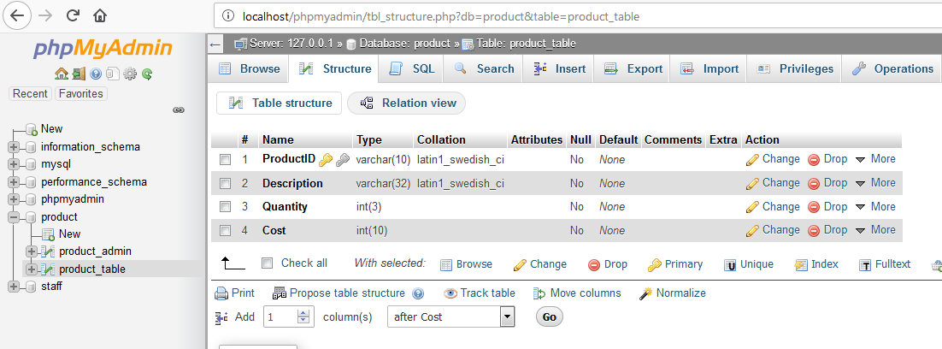
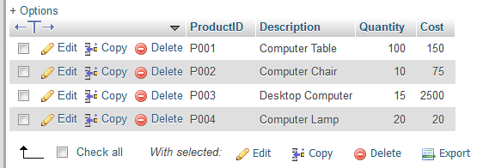
Database Structure

Slide 4
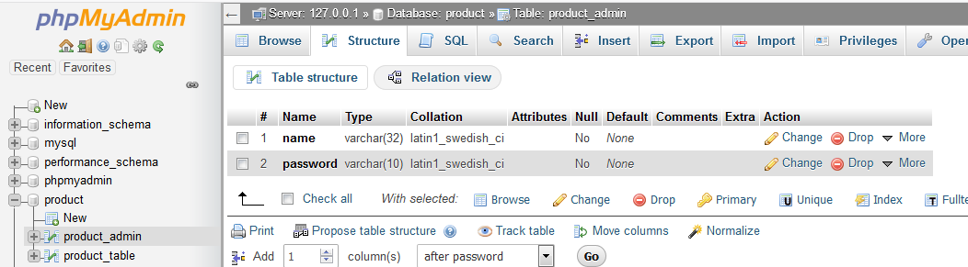

Database Structure

Slide 5
PHP & MySQL
Based on Database structure
  The following examples illustrate using PHP scripts to
    list all products
    add new product
    update existing product
    delete product
  There is also a main menu for accessing the above scripts in each PHP page.

Slide 6
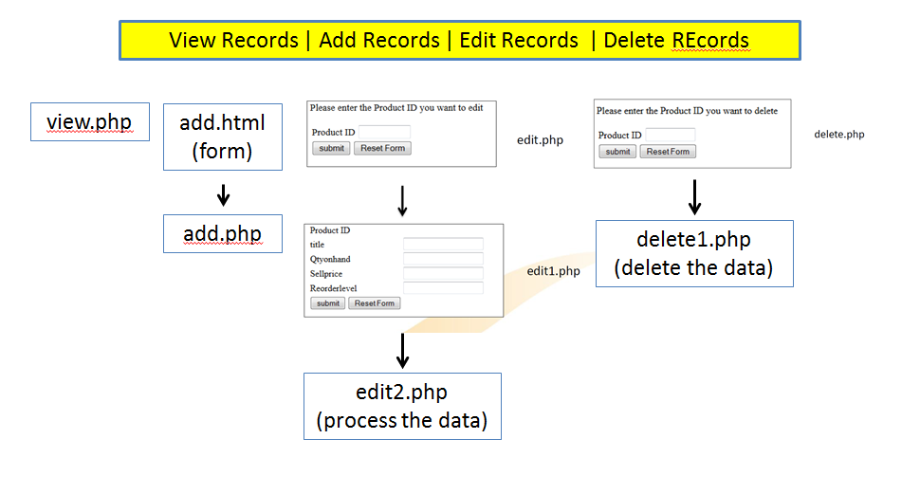
PHP & MySQL
Admin Login

Slide 7
PHP & MySQL
adminForm.php
Adminlogin.php (process the login)
Admin Login
Add.php
product.php
logout.php
Add Record
View Record
Logout
View Record
Delete Record
Edit Record
edit.php
Update Record

Slide 8
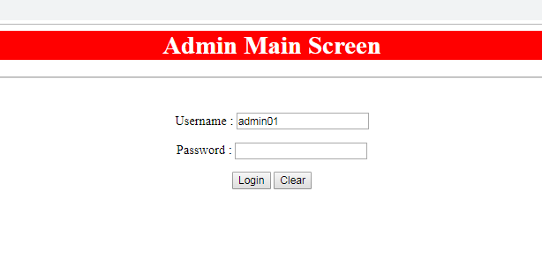
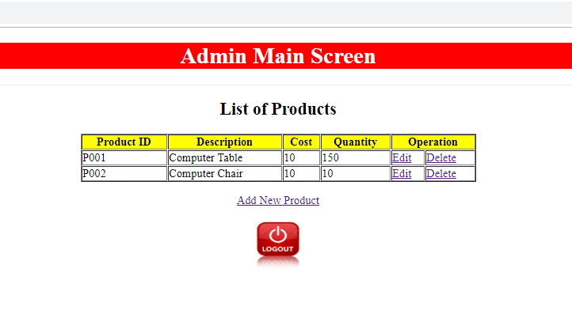
PHP & MySQL

Slide 9
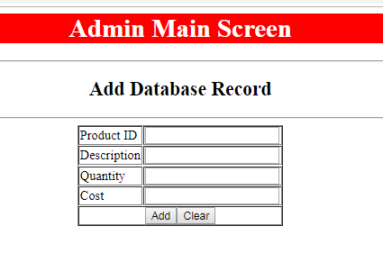
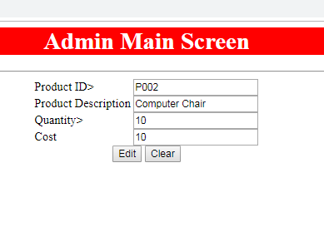
PHP & MySQL

Slide 10
header.php
<?php
echo "<center>
<h1 style='background-color:red;color:white;'>Admin Main Screen</h1>
<hr>";
?>
dbConnect.php
<?php
$server = "localhost";
$user = "root";
$passwd = "";
$database = "product";
$connect = mysqli_connect ($server,$user,$passwd,$database) or die("could not connect to database");
?>
Special.js
// delete Product function
function deleteProduct(){
var deleteProduct = confirm("Do you want to delete this Product?");
if (deleteProduct == true) {
return true;
} else {
return false;
}
}

Slide 11
adminForm.php
<html>
<head>
<title>For Administrator Only</title>
</head>
<body>
<?php include 'header.php'; ?>
<form name="login" action="adminlogin.php" method="post">
<br><p>Username : <input type="text" name="username" required/></p>
<p>Password : <input type="password" name="password" required/></p>
<p><input type="submit" value="Login" />
<input type="reset" value="Clear" /></p>
</center>
</form>
</center>
</body>
</html>

Slide 12
adminForm.php
<html>
<head>
<title>For Administrator Only</title>
</head>
<body>
<?php include 'header.php'; ?>
<form name="login" action="adminlogin.php" method="post">
<br><p>Username : <input type="text" name="username" required/></p>
<p>Password : <input type="password" name="password" required/></p>
<p><input type="submit" value="Login" />
<input type="reset" value="Clear" /></p>
</center>
</form>
</center>
</body>
</html>

Slide 13
adminLogin.php
<!DOCTYPE html>
<html>
<head><title>Admin - Product Menu</title></head>
<body>
<?php include 'dbConnect.php';?>
<?php include 'header.php'; ?>
<?php
$adminID = $_POST["username"];
$adminPasswd = $_POST["password"];
mysqli_select_db($connect,$database);
$query = "SELECT * FROM product_admin WHERE name='".$adminID."' And password='" .$adminPasswd. "'";
$result = mysqli_query($connect,$query);
$myrow = mysqli_fetch_array($result,MYSQLI_ASSOC);
if (!$myrow){
print "<div class='h1'>Wrong admin ID or wrong password</div>";
print "<div class='h1'>Please try again</p>";
}
else {
header("Location: product.php");
}
mysqli_close($connect);
?>
<a href=adminForm.php>Click here</a>
</center>
</body>
</html>

Slide 14
<!DOCTYPE html>
<html>
<head> <title>Product Sample</title> </head>
<body>
<?php include 'header.php'; ?>
<?php include 'dbConnect.php';?>
<?php
// retrieve data from product
$getProductQuery = "SELECT * FROM product_table";
$getProduct = $connect->query($getProductQuery);
?>
<center>
<h2>List of Products</h2>
<table border="1" width="30%">
<tr bgcolor="yellow">
<th>Product ID</th> <th>Description</th> <th>Cost</th><th>Quantity</th><th colspan="2">Operation</th>
</tr>
<?php
if ($getProduct->num_rows > 0) {
while($row = $getProduct->fetch_assoc()) {
?>
<tr>
<td><?=$row['ProductID'];?></td> <td><?=$row['Description'];?></td>
<td><?=$row['Quantity'];?></td> <td><?=$row['Cost'];?></td>
<td><a href="edit_product.php?id=<?=$row['ProductID']?>">Edit</a></td>
<td><a onClick="return deleteProduct();" href="product.php?id=<?=$row['ProductID']?>">Delete</a></td>
</tr>
<?php
}
}
?>
</table>
Product.php

Slide 15
Product.php
<p \><a href="add_product.php">Add New Product</a>
<p \><a href="logout.php"><img src="logout.jpg" width="75" height="75"></a>
</center>
</body>
<script src="special.js"></script>
</html>
<?php
// delete Product
if (isset($_GET['id'])) {
$deleteProductquery = "DELETE FROM product_table WHERE ProductID = '" .$_GET['id']."'";
$deleteProduct = $connect->query($deleteProductquery);
header("Location: product.php");
}
?>

Slide 16
<?php include 'header.php';?>
<?php include 'dbConnect.php';?>
<?php
if (isset($_GET['id'])) {
$getProductQuery = "SELECT * FROM product_table WHERE ProductID = '".$_GET['id']."'";
$result = $connect->query($getProductQuery);
while($row=$result->fetch_assoc()) {
/* store current user info in variables */
$prodID = $row['ProductID'];
$desc = $row['Description'];
$qty = $row['Quantity'];
$cost = $row['Cost']; }
}
?>
<body>
<form action="" name="editProduct" id="editProduct" method="post">
<table>
<tr>
<td>Product ID></td> <td><input type="text" id="prodID" name="prodID" value="<?=$prodID?>"></td>
</tr>
<tr>
<td>Product Description</td> <td><input type="text" id="desc" name="desc" value="<?=$desc?>"></td>
</tr>
<tr>
<td>Quantity></td> <td><input type="text" id="qty" name="qty" value="<?=$qty?>"></td>
</tr>
<tr>
<td>Cost</td> <td><input type="text" id="cost" name="cost" value="<?=$cost?>"></td>
</tr>
<tr>
<td colspan="2" align="center"> <input type="submit" name="edit" id="edit" value="Edit">
<input type="reset" name="reset" id="reset" value="Clear"></td>
</tr>
</table> </form></body> </html>
Edit_Product.php

Slide 17
Edit_Product.php
<?php
// update enrollment
if (isset($_POST['edit'])) {
$prodID = $_POST['prodID'];
$desc = $_POST['desc'];
$qty = $_POST['qty'];
$cost = $_POST['cost'];
$editProductQuery = "UPDATE product_table SET ProductID = '$prodID',
Description = '$desc',
Quantity = '$qty',
Cost = '$cost'
WHERE ProductID = '".$_GET['id']."'";
$editProduct = $connect->query($editProductQuery);
if ($editProduct) {
header('Location: product.php');
}else {
echo "Error: " .$connect->error;
}
}
?>

Slide 18
Add_Product.php
<?php include 'header.php';?>
<?php include 'dbConnect.php';?>
<?php
if (isset($_POST['submit'])) {
$productID = $_POST['ProdID'];
$description = $_POST['Desc'];
$quantity = $_POST['Qty'];
$cost = $_POST['Cost'];
$product_query = "INSERT INTO product_table(ProductID, Description, Quantity, Cost)
VALUES ('$productID','$description','$quantity','$cost')";
$add_record = $connect->query($product_query);
if ($add_record) {
header('Location: product.php');
}else {
echo "Error inserting record: " . $connect->error;
}
mysqli_close($connect);
}
?>

Slide 19
Add_Product.php
<html>
<head>
<title>Add New Database Record</title>
</head>
<body>
<center>
<h2>Add Database Record</h2>
<hr />
<form name="product" action="" method="post">
<table border="1">
<tr><td>Product ID</td><td><input type="text" name="ProdID" required/></td></tr>
<tr><td>Description</td><td><input type="text" name="Desc" required/></td><tr>
<tr><td>Quantity</td><td><input type="text" name="Qty" required/></td></tr>
<tr><td>Cost</td><td><input type="text" name="Cost" required/></td></tr>
<tr><td colspan="2"align="center"><input type="submit" name="submit" id="submit" value="Add">
<input type="reset" value="Clear" /></td></tr>
</table>
</form>
</center>
</body>
</html>

Slide 20
logout.php
<?php
session_start();
?>
<!DOCTYPE html>
<html>
<Head>
<meta http-equiv="Refresh" content="3;url=adminForm.php">
</head>
<body>
<?php
// remove all session variables
session_unset();
// destroy the session
session_destroy();
echo "All session variables are now removed, and the session is destroyed."
?>
</body>
</html>

